Slide 1

Reproducible Research Reporting in R with Markdown - Quarto
By: Yohanis Alemeshet

Slide 2
Outline
Why Markdown?
Understanding the anatomy of Quarto
Markdown essentials
Figures and tables
Static Vs Interactive plots

Slide 3
Use basic Markdown syntax (headings, lists, emphasis) in a Quarto document.
Create and run R code chunks inside Quarto.
Produce tables and figures suitable for inclusion in a manuscript.
Add citations, cross-references, and a bibliography.
Render the same report to multiple formats (HTML, PDF, Word).
Apply a simple workflow to create publication-ready reports from R.

Slide 4
What is Markdown
Markdown is a simple markup language for formatting plain text
  Headings
  Lists,
  Links
  Bold, italics, etc. . . that can be rendered to HTML, PDF, Word, and more.

Slide 5
Why reproducible reporting
Analyses are often done in R, but results are copied manually into Word/PowerPoint.
This manual process is slow, error-prone, and hard to reproduce.
Quarto/R-markdown lets you combine code, text, tables, and figures in one document.

Slide 6

Quarto
Quarto is a next-generation, open-source framework for reproducible publishing.
It supports R, Python, Julia, and multiple output formats.
If you’ve used R Markdown: Quarto is its modern successor with more features, but the core ideas are the same.

Slide 7
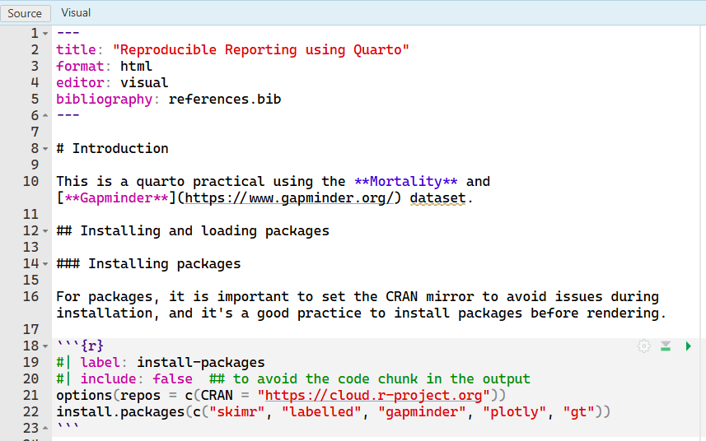
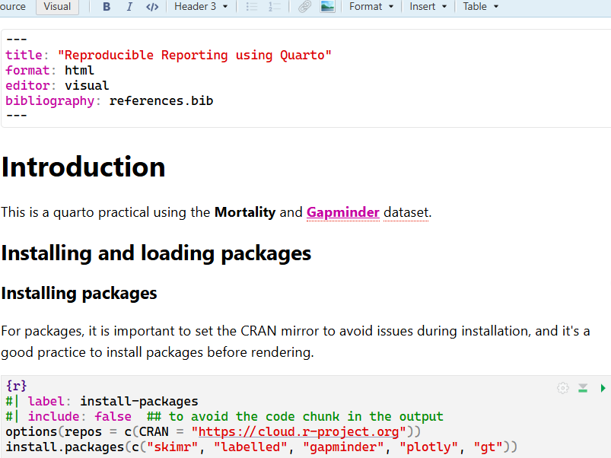
R markdown Vs Quarto

Slide 8
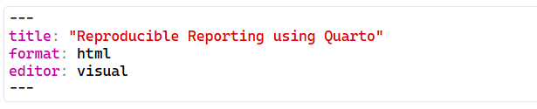
Anatomy of Quarto
YAML header
Metadata of our document.
What kind of document are you creating (HTML, PDF, Word, slides)
Document title, author, date
Formatting options (themes, layout, toc, code folding, highlighting)
Bibliography and citations

Slide 9
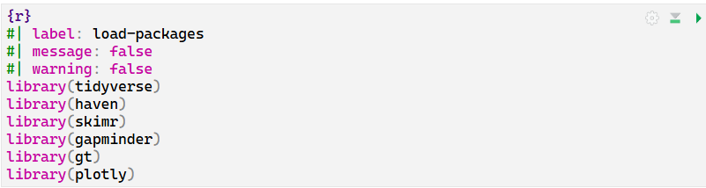
Code chunks
Code chunk begins with {R}
Optional chunk option in YAML style #|

Slide 10
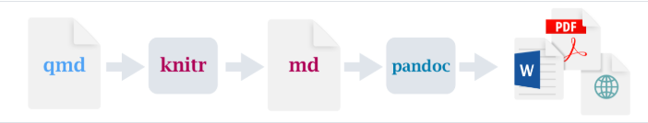

How Quarto works?

Slide 11
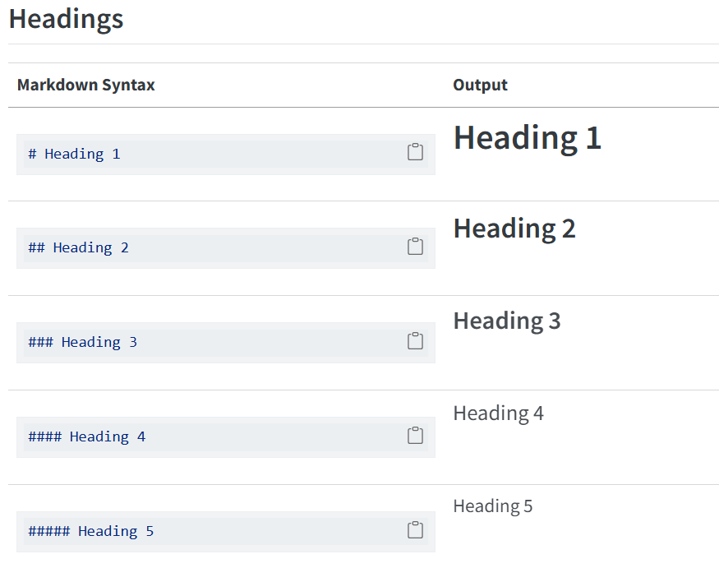
Basic Markdown

Slide 12
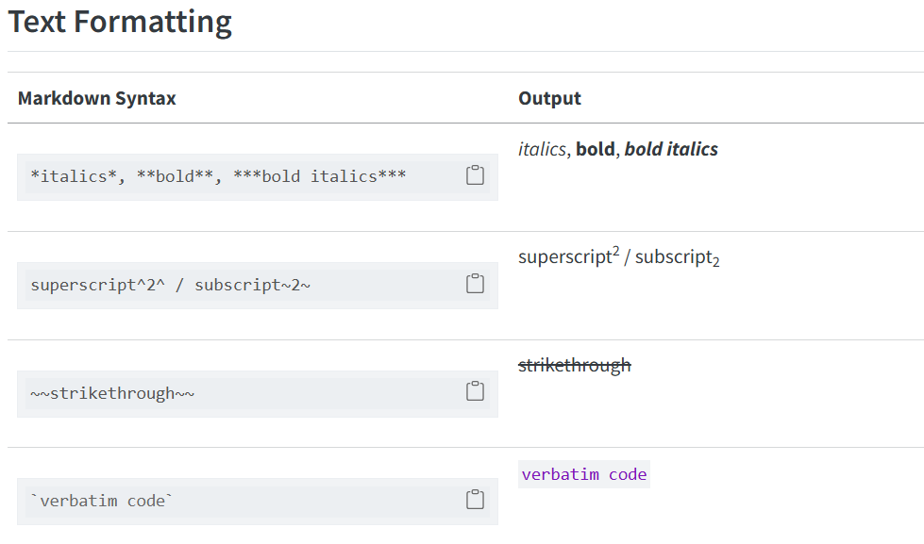
Basic Markdown . . . .

Slide 13
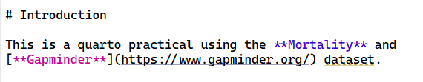
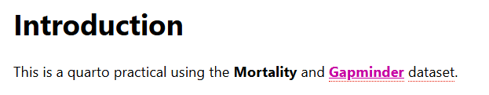
Links

Slide 14
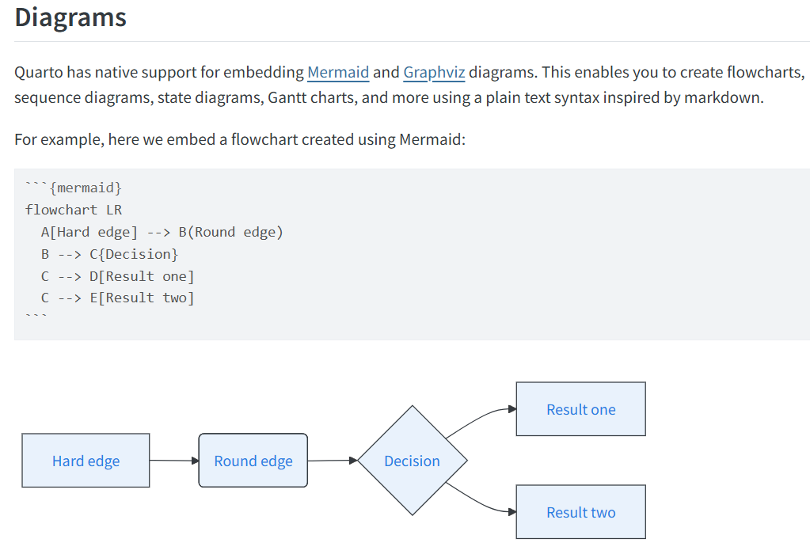

Slide 15
Exercise
Using the Gapminder dataset, create a table of life expectancy by GDP per capita for sub-Saharan Africa.
Add the visualisation of the life expectancy of Ethiopia from 1952 to 2007 using a line graph.

Slide 16
Thank You!

